Slide 1



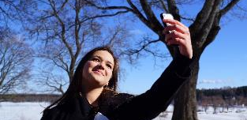
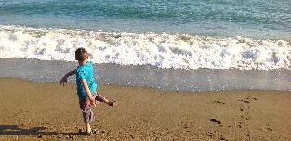
Win Prizes
Sign up
in photo competition
or
First name
Share Moments
Last name
Email
Email
Password
Password
Log in
Birthday
Refresh Your Mind
Forgot password?
Female
Male
By clicking Create account you agree to our Terms of use
Sign up
Create Account
Log in
Sign up
Log in
Copyright 2016
Landing Page
Value Propositions
Sign up

Slide 2









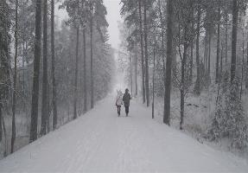



Search
Search
Search
Recent uploads
Kafil
Gallery
Prizes
Photography Tips
Competition Terms
Winter night
5m
Feeds
Kafil
Walkway to LUT
5m
20
1
Sneha
5m
Beautiful girl
50
2
Home
Home page continues
Competition Page

Slide 3

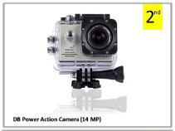
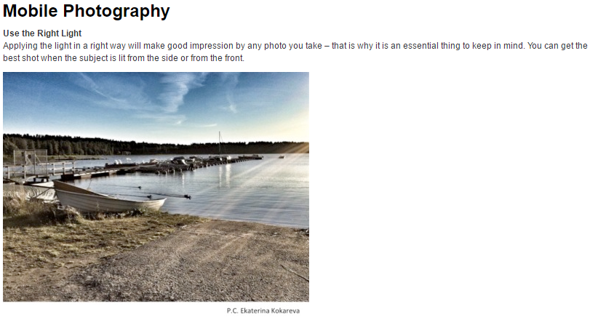
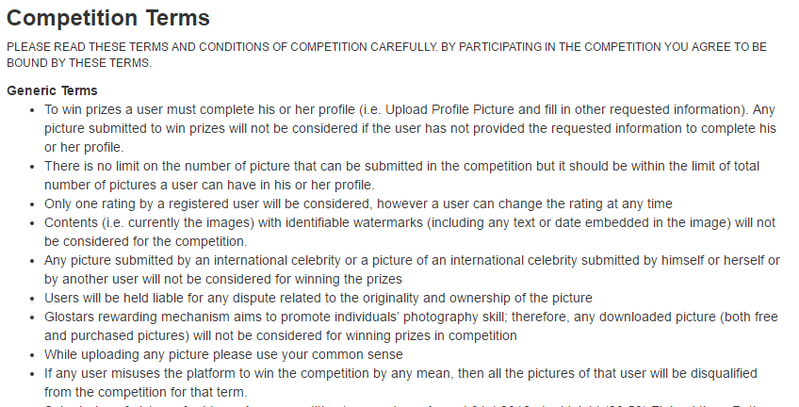
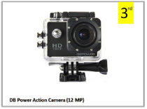
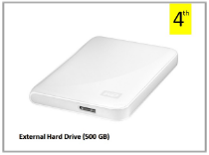
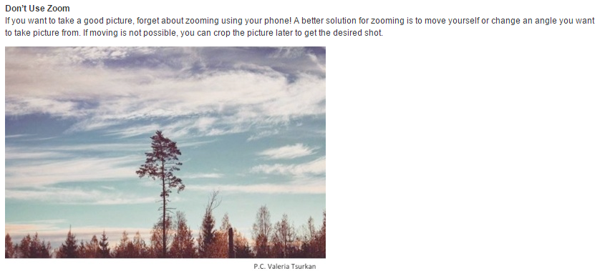
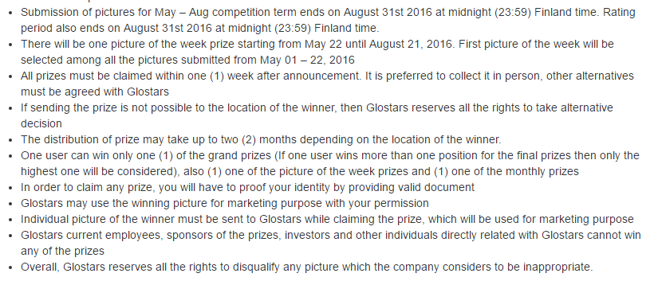

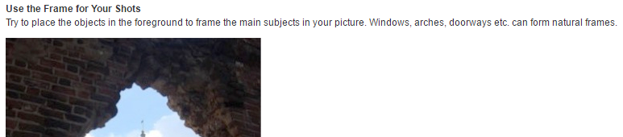
Search
Search
Search
Gallery
Prizes
Photography Tips
Competition Terms
Gallery
Prizes
Photography Tips
Competition Terms
Gallery
Prizes
Photography Tips
Competition Terms
Competition Page >> Prizes
Competition Page >> Tips
Competition Page >> Terms

Slide 4

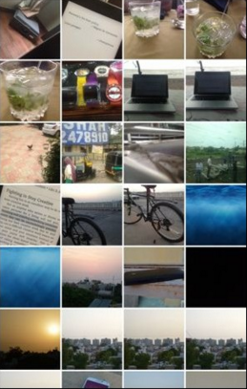
Search
Library
Camera
Camera

Slide 5
Rules
Slide 1: The first page will have three sliding pages. It should move with Finger Swiping
Navigation Bars: Top Navigation Bar will have Logo and Search Bar. Bottom Navigation Bar will Home, Competition, Upload, Notification and Profile menu
Slide 2: Home page will start with Recent Uploads section with 15 pics options to be swiped and view
Slide 2: After Recent Uploads, there will be Feeds section with my pictures and pictures uploaded by the users who the logged in user is following
Slide 2: Each post in the feed will have- profile pic, name, picture description, time of upload, category of upload (i.e. mutual followers/public/competition) symbol. And a star symbol (either filled in ash colour or blank), it will be filled in ash colour if Logged in user have rated the picture already

Slide 6






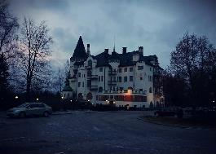


Sajib Saha
Sajib Saha
Liza Baryshnikova
Simplicity and class, the things I like. :)
Simplicity and class, the things I like. :)
98 Friends
98 Friends
7 Friends
Imatra
8w
abu
Friends
Jani
Add
200
5
Emmi +14
Emmi
Nice!
Profile
Friends
Profile timeline

Slide 7









2
Abu Tahir
16:20
Jani Hotakainen starred your picture 5m
Anastasiia Zhuikova About text(50 characters)
Hey, how are you doing?
Anastasiia Gusakova
1d
Anastasiia Gusakova starred your picture 10m
Where was your last photo tak…
Rajib Sinha About text
Ekaterina Kokareva commented: “Beautiful!” 1d
2
Notifications
Friend requests
Messages

Slide 8





Edit profile
Gallery
Prizes
Tips
Terms
Change Picture
Change email & password
Your activity
First name
Notifications
Sajib
Last name
Linked accounts
Saha
Glostars
About me
About Us
Simplicity and class, the things I like. :)
Terms
Data privacy
Interests
FAQ
Maximum 160 characters
Contact Us
Log out
Settings
Edit Profile
Competition screen

Slide 9




Library
Camera
Library
Camera
Friends
Public
Competition
We would like to introduce the possibility of superposing photos from front and back camera
Description
Tag place
Tag person
Share to
Facebook
Twitter
Vkontakte
Upload Screen
Upload Screen
Upload Screen

Slide 10




nawrin Nawab
15 mutual friends
Anastasiia Zhuikova
8 mutual friends
Rajib Sinha
5 mutual friends
All people
Visit Lappeenranta
All pages
#lappeenranta
All tags
Lappeenranta
All places
While Searching

